Slide 1



MICROWAVE
FILTERS
Submitted by: Joel Roy

Slide 2


INTRODUCTION
Microwave filters are designed to selectively pass certain frequencies of electromagnetic signals while attenuating or blocking others. They help ensure that the desired signal bandwidth is transmitted accurately while minimizing interference from neighboring frequency bands.
Filters are employed in various applications, including wireless communication systems, satellite communication, radar systems, electronic warfare, and test and measurement equipment.
2

Slide 3
For our project , we simulated four type of filters for Gigahertz and Terahertz frequencies.
Capacitively-Coupled Resonators for Terahertz Planar-Goubau-Line Filters
Dual split resonator lowpass filter with ultrawide stopband and sharp roll-off Rate.
Improved Frequency Response of Microstrip Lowpass Filter Using Defected Ground Structures.
Design of THz low pass filter using split-ring resonator
3

Slide 4
CAPACITIVELY-COUPLED RESONATORS FOR TERAHERTZ PLANAR-GOUBAU-LINE FILTERS
4

Slide 5
VISION
Introduction to THz technology and the interest in planar Goubau lines:
THz technology holds promise for various applications.
Planar Goubau lines have attracted attention due to their low-loss properties.
Challenges posed by single-wire waveguides in component development:
Single-wire waveguides limit design flexibility for standardized components.
Overcoming these limitations is crucial for practical implementations.
Research objective: Design and implement a tailored bandpass/bandstop filter:
The study aims to address the need for standardized components in THz technology.
Focus is on developing a filter optimized for planar Goubau lines.
Definition of Planar Goubau Line Filters (PGLFs) and their structure:
PGLFs operate by guiding electromagnetic waves along planar Goubau lines.
Structure consists of a conductive strip above a dielectric substrate.
5

Slide 6
5. Unique propagation characteristics of Goubau waves:
Goubau waves exhibit distinct propagation behavior along the interface.
Characteristics include low radiation losses and strong field penetration.
6. Innovation: Integration of periodically loaded capacitively-coupled λ/2 resonators:
Resonators are strategically incorporated to enhance filter tunability.
Electrical length manipulation offers unprecedented flexibility in design.
7. Introduction of a sophisticated transmission-line model:
A transmission-line model is introduced to elucidate filter operation.
Model reveals the intricate interplay between resonator loading and wave propagation.
8. Significance of the novel approach in filter design optimization:
The novel approach overcomes constraints of single-wire waveguides.
Transmission-line model enables precise optimization and fine-tuning of filter design.
6

Slide 7
DESIGN
Substrate is characterized by a bulk permittivity of εr = 11.7
Tangent loss tan δ = 1.7 × 10−5
Gold as a conductor (σ = 4.1 × 107 S/m)
Large strip width of wp = 10μm --decreases conductor loss
The resonator width and gap we took wr = 5 μm and gr = 5 μm --o guarantee subwavelength structure and operate well below the Bragg frequency
Coupling gap of gc = 10 μm
7

Slide 8
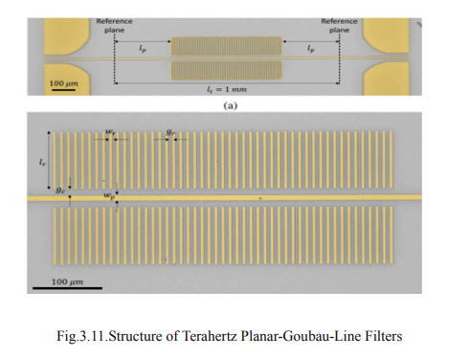
8

Slide 9
RESULTS
Loss Characteristics: Investigation reveals relatively low attenuation in the fabricated PGL, indicating its potential for THz applications.
Filter Performance: Comparison between experimental and simulated S-parameters demonstrates excellent agreement, validating the filter's design and functionality.
Band Characteristics: Identification of passband and stopband frequencies, along with their respective bandwidths, provides crucial insights into the filter's frequency response.
Insertion Loss: Despite slightly higher insertion loss compared to resonator-free PGLs, the fabricated filter remains competitive for practical THz applications.
Challenges and Optimization: Recognition of asymmetrical passband responses and ripple effects highlights the complexity of THz filter design, emphasizing the need for further optimization and refinement.
9

Slide 10
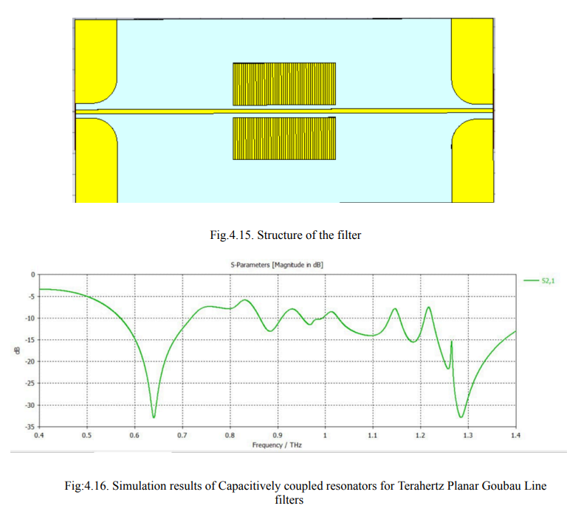
10

Slide 11
DUAL SPLIT RESONATOR LOWPASS FILTER WITH ULTRAWIDE STOPBAND AND SHARP ROLL-OFF RATE
11

Slide 12
Modern research studies are now searching for novel approaches in the field of filters, as these are the important component for all the circuits which are (narrow or a wide band) frequency-dependent.
Split ring resonator (SRR) structures are commonly created with different shapes such as square, circular, and spiral where the frequency response can be improved using such structures. The performance of the conventional lowpass filter can be improved by increasing the number of resonators and lumped elements at the cost of enlarged size and poor passband characteristics
12

Slide 13
Usual conventional split-ring resonators show square, circular, or spiral shapes with single split and having high impedance stubs. They show poor performance.
After the detailed survey of SRR, and other approaches, the design procedures are found to be common by using the SRR with different geometry and etched in the ground plane. The splits in the geometry of resonators can make a difference in the performance characteristics of the filters and the proposed resonators can replace the other SRR for the enhancement in the filter response.
13

Slide 14
DESIGN
Conventional constructions of split resonators are by using concentric rectangular loop split rings. Here split resonators (SR-1 and SR-2) with dual splits (DSR-1 and DSR-2) are designed on a substrate with a thickness of 0.79 mm, loss tangent 0.0009 and having a dielectric constant of 2.2 to obtain better coupling and achieve maximum frequency performance
14

Slide 15
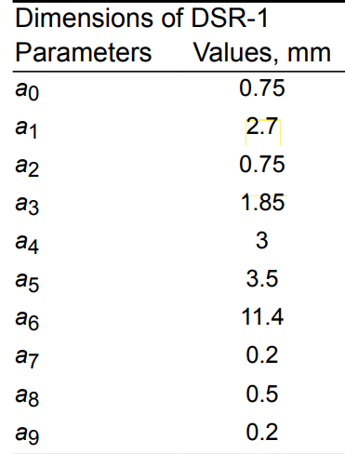
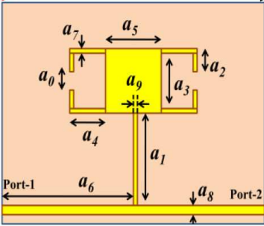
DUAL SPLIT RESONATOR-1 (DSR-1)
15

Slide 16
Splits on both sides of a rectangular loop with low impedance patch, which are placed on the high impedance stub constitute DSR-1. Here a0 denotes the splits in the rectangular loop and a5 gives the low impedance patch with ZC1= 38.83 Ω . The loop having splits on both sides are placed on high impedance stub showing a1 and having characteristic impedance of ZL1= 159.03 Ω .
. DSR-1 resonates at 4.3 GHz.
16

Slide 17
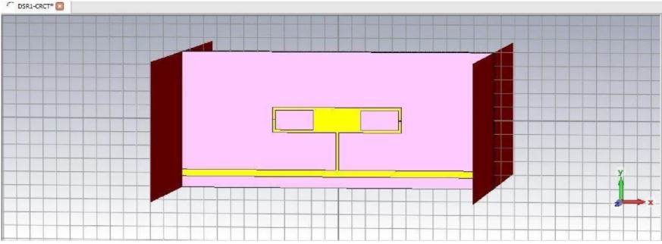
17

Slide 18
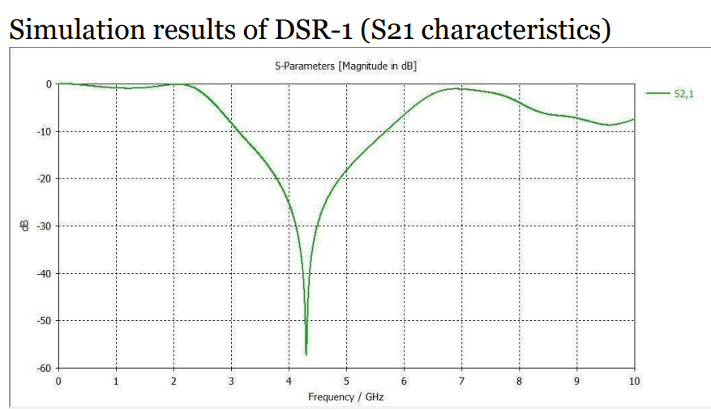
18

Slide 19
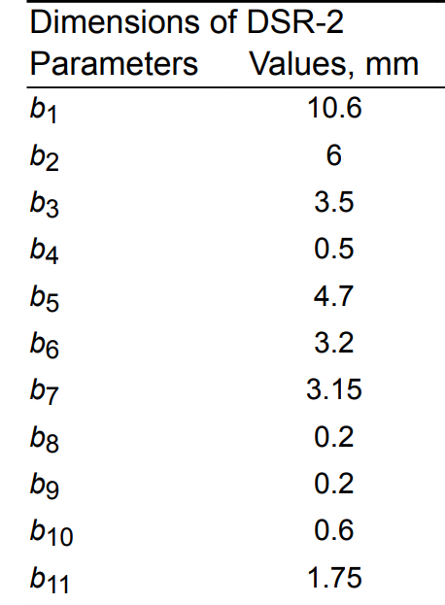
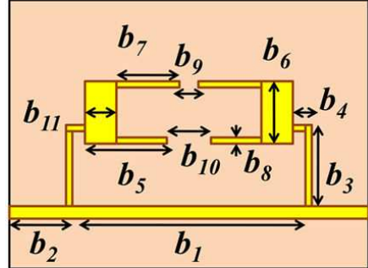
DUAL SPLIT RESONATOR-2(DSR-2)
19

Slide 20
The rectangular loop resonator having dual splits on top and bottom form DSR-2. It is placed on a bent high impedance stub shown in Fig.
The DSR-2 is a rectangular loop with a low-impedance patch on both sides.
The proposed DSR-1 and DSR-2 are not regular-shaped structures and EM simulations are encountered with some parasitic effects along with dielectric losses and conductor losses as it comes to the substrate material
The DSR-2 having resonators designed on both sides achieves two resonances fz1 and fz2 with 35 and 65 dB attenuation, respectively.
20

Slide 21
In this resonator we get two transmission zeros at 4.6GHz and 6 GHz and the output field at 4.6 GHz are found to be higher than 6 GHz.
It is observed that, according to the dimensions of the loop in the DSR-2, the attenuation level of first and second transmission zero varies.
21

Slide 22
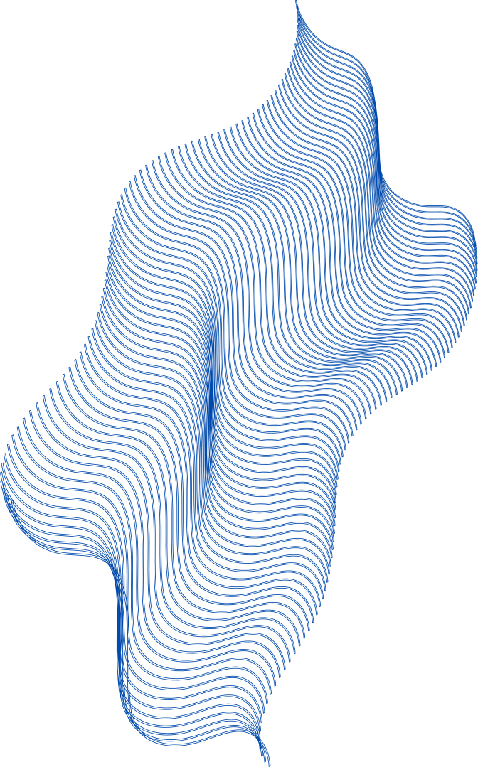
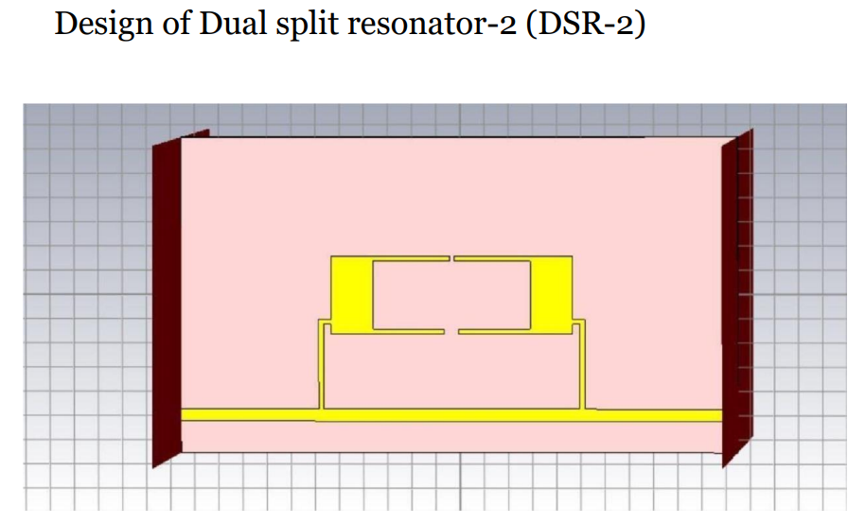
22

Slide 23
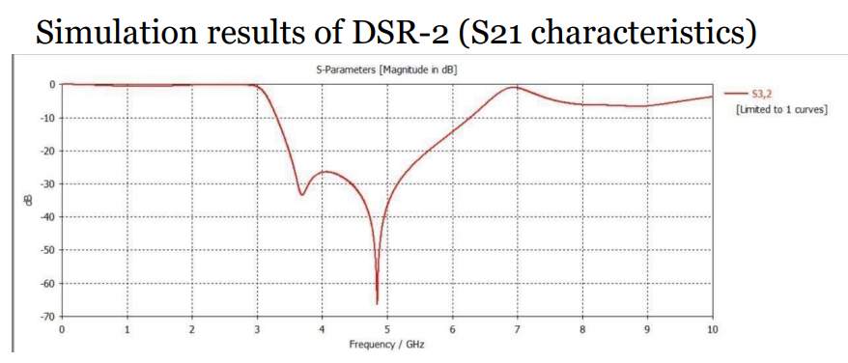
23

Slide 24
Analysis of cascaded DSR structure
24

Slide 25
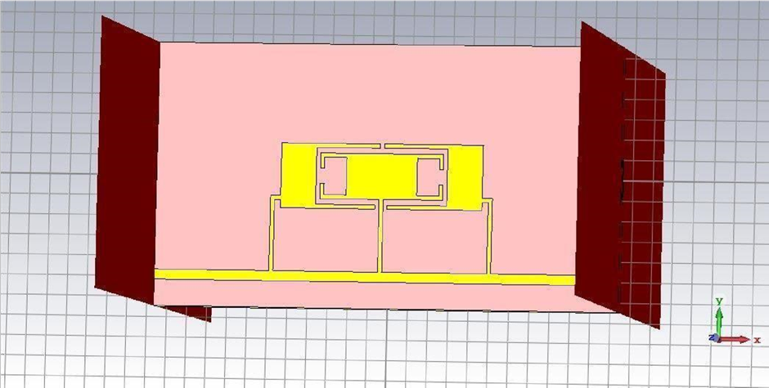
Cascaded structure of DSR1 and DSR2
25

Slide 26
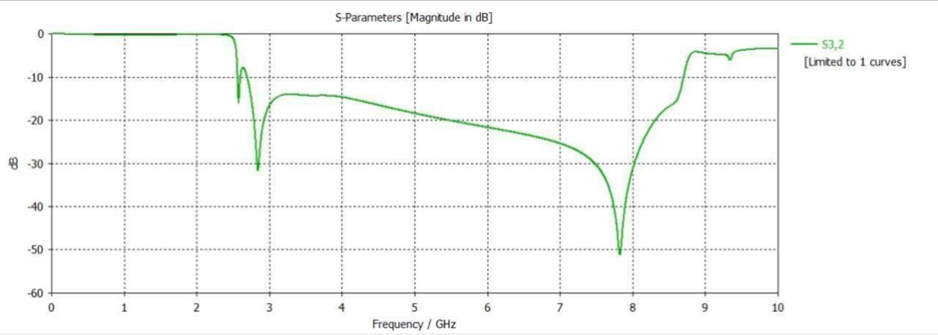
Simulation results of Cascading DSR1 and DSR2
26

Slide 27
The DSR structure placed in parallel, on the high impedance transmission line will decrease the effective impedance of the resonator circuit .It also provides further suppression at the stopband and widens the region beyond cut-off frequency.
DSR-1 and DSR-2 are cascaded together after the coupling gap optimization.
It is observed that the stopband width and the skirt selectivity of the filter are enhanced using the cascaded structure with Cg = 0.2 mm.
It shifts the first transmission zero from 3.1 to 3.5 GHz on further increase in the coupling gap
27

Slide 28
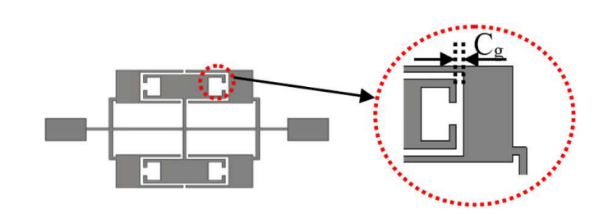
28

Slide 29
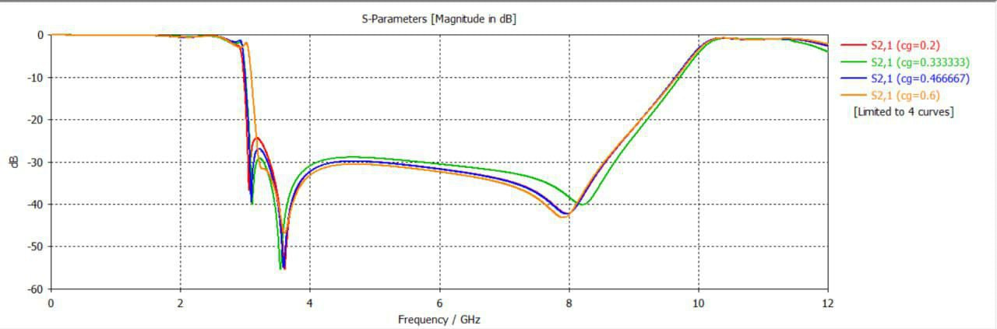
Frequency response of cascaded DSR structure for the variation in Cg
Shift in first transmission zero from 3.1to 3.5 GHz on further increase from cg=0.2(red curve) to cg=0.6 (orange curve)
29

Slide 30
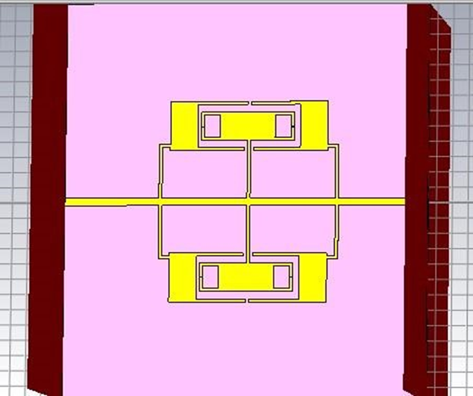
Parallel Cascaded DSR1 and DSR2 in the simulation
30

Slide 31
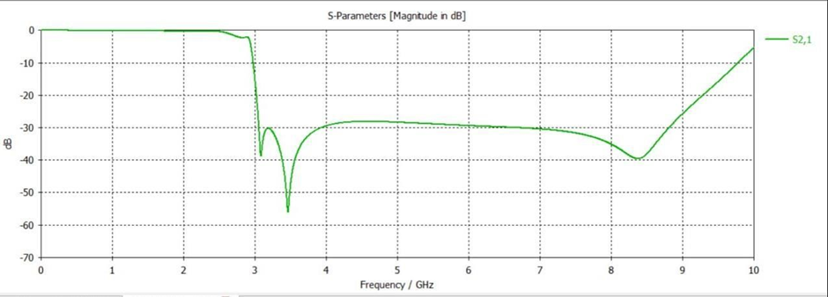
Simulation results of Parallel Cascaded DSR1 and DSR2
31

Slide 32
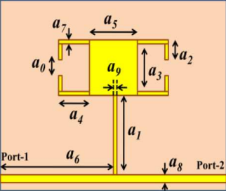
The horizontal stub length (a4) and center patch width (a5) of DSR-1 are varied for and observed the frequency response.
The cut-off frequency of the proposed structure deviates from changing the stub length and a slight variation in the position of the transmission zero is observed.
The stopband width shifts towards the lower frequencies.
Hence stub length is taken as 3 mm which is a compromise
between stopband width and suppression level and we
observed the results.

Slide 33
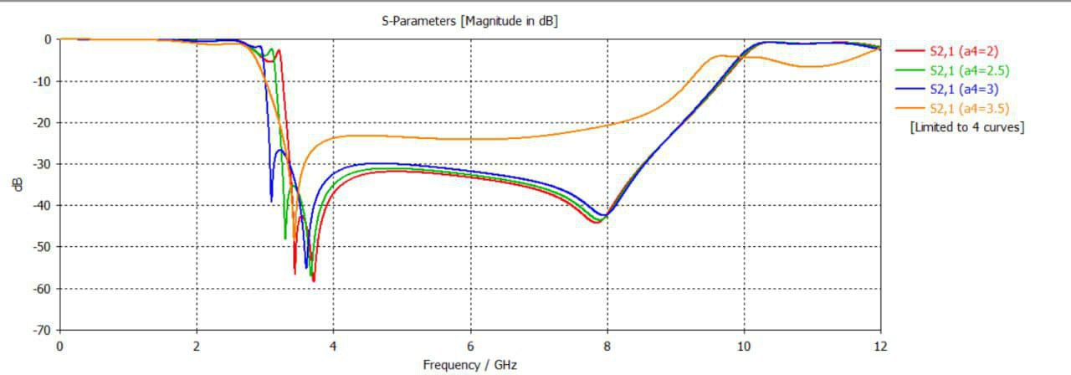
Frequency response of cascaded DSR structure for the variation in a4
As the value of a4 increases(orange curve has highest a4 value=3.5)The stopband width shifts towards the lower frequencies.
33

Slide 34
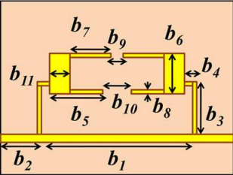
The vertical stub length (b3) of DSR-2 shows a drastic effect on the position of transmission zeros in the filter response they shift towards the cut-off frequency for higher values of the vertical stub length
The stopband region is reduced with poor suppression after the first transmission zero.
First transmission zero moves towards the cut-off frequency for the higher patch width. Since the filter has size limitations, the patch
width is optimised to 1.75 mm after considering the
stopband area

Slide 35
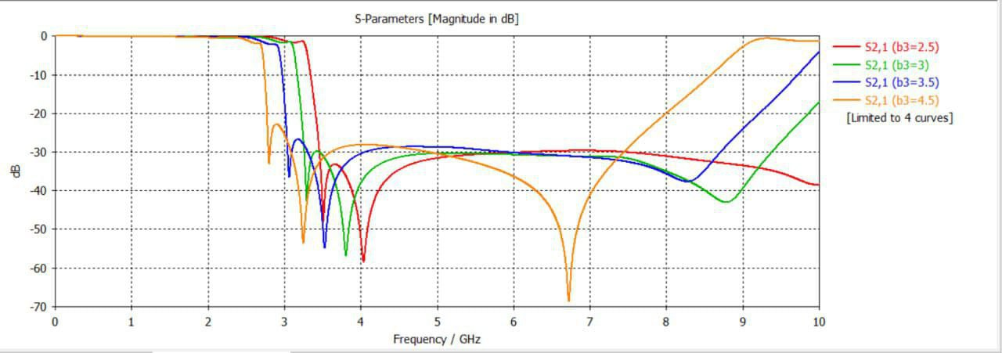
Frequency response of the cascaded DSR structure for the variation in b3
35

Slide 36
There is a significant change in the roll-off of the filter and an optimum value of 3.5 mm is selected after considering the attenuation level of the S21 characteristics.
The selectivity and cutoff frequency of the filter are improved for the slight changes in the patch width (b11) of DSR-2

Slide 37
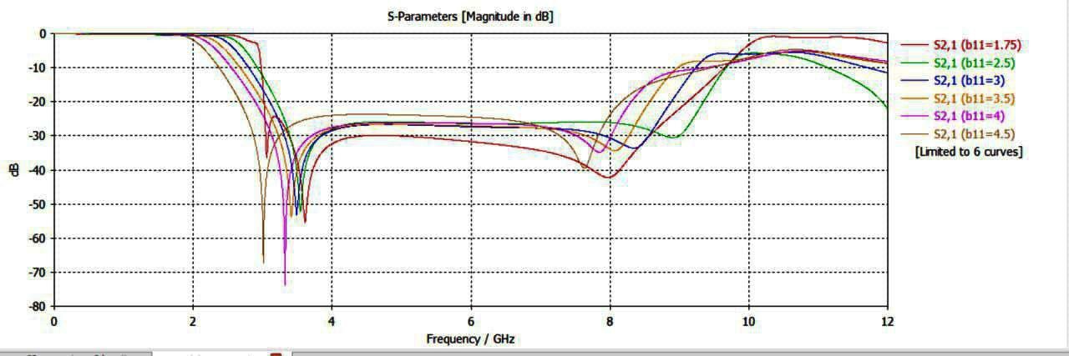
Frequency response of the cascaded DSR structure for the variation in b11
37

Slide 38
As we know tuning of the cut-off frequency can be effectively carried out by modifying the proposed DSR structure.
The increase in the width of the low impedance patch in both DSR-1 and DSR-2 reduces the cut off frequency due to the variation in the lumped equivalent values
Similarly, the length of the horizontal stub increases, a more stable transition from passband to stopband occurs. Furthermore, horizontal stub length reduces the effect of patch capacitance in the filter response, thereby increases the cut-off frequency.
The vertical stub length in both resonators will result in the reduction of cut-off frequency due to the increase in the stub inductance value. However, it is not possible to reduce the cut-off frequency beyond a limit due to the size constraint
38

Slide 39
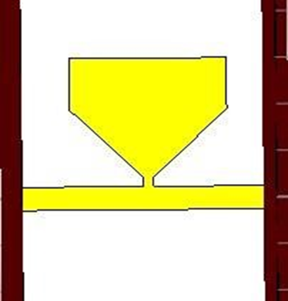
Tuning of the cut-off frequency can also be accomplished by changing the split distance without affecting physical circuit size, we now have designed the dimensions of FSSC with C1 = 3.1 mm, C2 = 2.55 mm, C3 = 0.2 mm, C4 = 0.6 mm, C5 = 0.2 mm
Supressed cell
39

Slide 40
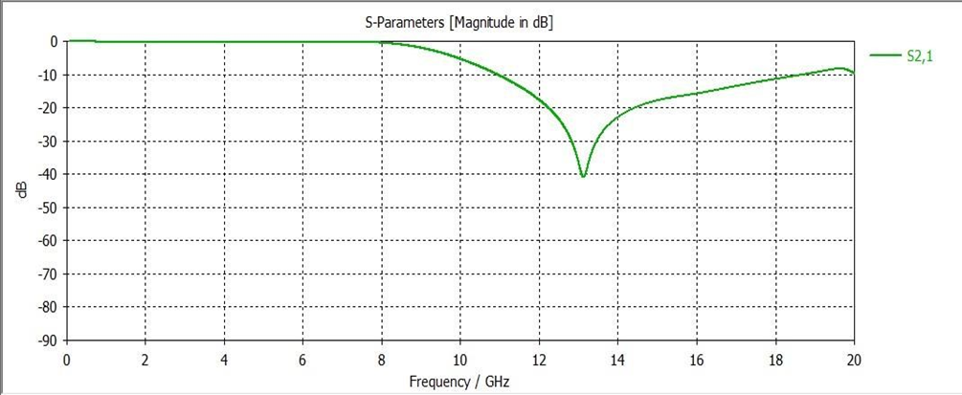
Simulation results of a supressed cell
40

Slide 41
The funnel-shaped suppressing cells (FSSC) which was shown previously resonate at a higher frequency of fz ′ = 13 GHz is symmetrically added to the DSR unit.
We designed the final DSR filter with suppressing cells and open stubs, which rejects higher harmonics with suppression of 22 dB beyond second transmission zero and 27 dB at 25 GHz
Beyond 10 GHz, deep suppression of 30 dB is achieved with minimum losses at the simulation results.
41

Slide 42
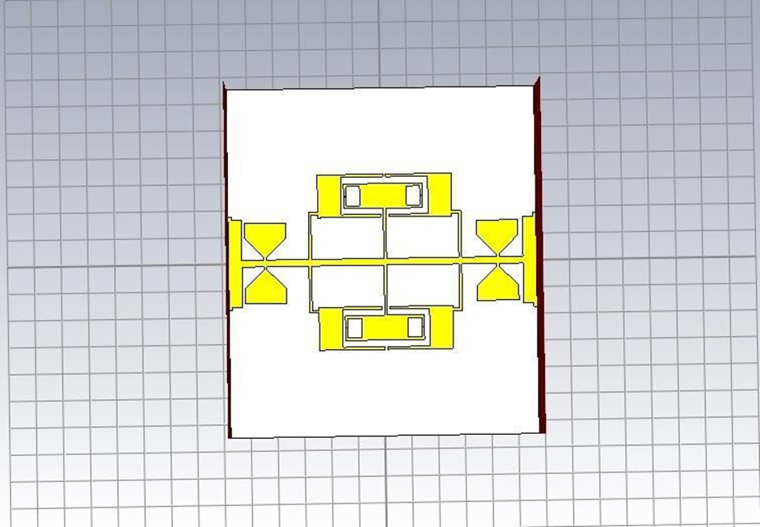
Final proposed DSR filter
42

Slide 43
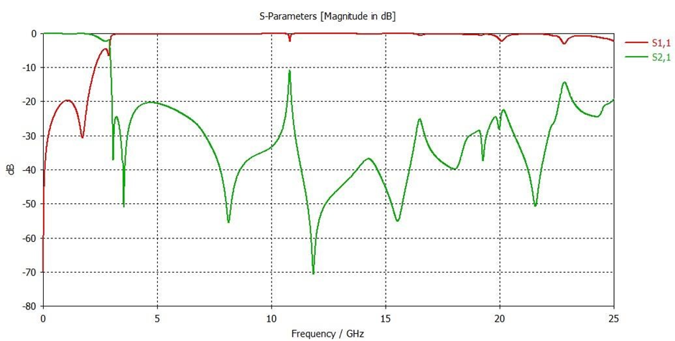
In the final simulation, the control on the transmission zeros and thereby its roll-off factor is configured by changing the stub length of the DSR-1 and DSR-2. Similarly, it is interesting to note that the control on extended stopband beyond 14 GHz depends upon the size of the suppressing cells.
Simulation result of the final proposed DSR filter
43

Slide 44
Improved Frequency Response of Microstrip Lowpass Filter Using
Defected Ground Structures
44

Slide 45
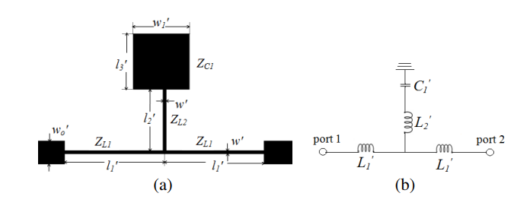
Primary Resonator
A series resonant branch having a high impedance stub and a low impedance patch, modeled as inductor and capacitor respectively is connected in shunt with a high impedance main transmission line
w = 0.2, w1 = 3.6, w2 = 3.7, w3 = 4.05, wo = 1.15, l1 = 2.8, l2 = 3.8,
l3 = 0.9, l4 = 3.6, l5 = 6.05, l6 = 3.6, l7 = 3.05, l8 = 3.6, l9 = 3.0, l10 = 4.55, lo = 13.0 (all in mm)
45
(a) Structure. (b) LC equivalent circuit.

Slide 46
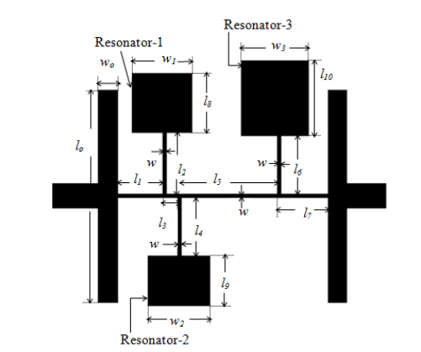
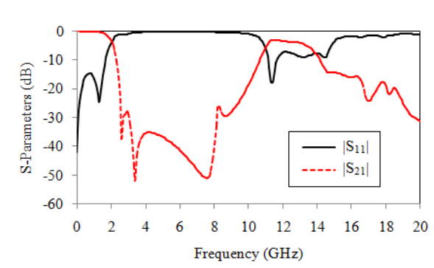
BASIC MICROSTRIP LOWPASS FILTER
Basic microstrip lowpass filter is designed using stepped impedance resonators and uniform impedance stubs (SIR-UIS)
The structure consists of two uniformly shaped low impedance stubs and three stepped impedance resonators, Resonator-1, Resonator-2 and Resonator-3 loaded on the high impedance main transmission line.
46

Slide 47
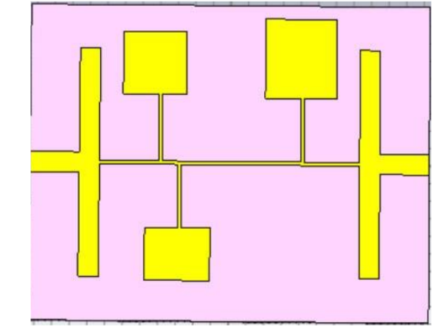
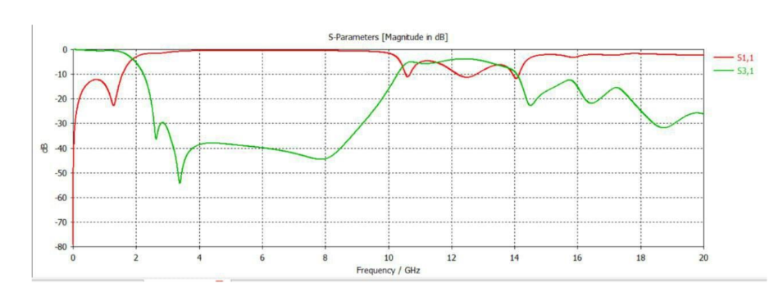
The cutoff frequency of the filter is 1.95 GHz
The insertion loss is less than 0.35 dB up to 1.1 GHz of the passband and the return loss in the passband is better than 14.7 dB
The physical size of the filter is only 15.1 mm × 14.95 mm
Basic lowpass filter
Simulation results of Basic lowpass filter
47

Slide 48

DEFECTED GROUND STRUCTURE (DGS)
used to enhance the bandwidth and gain of microstrip antenna
DGS is a purposefully created defect on the ground plane of a printed microstrip board.
It is typically created in the form of an etched-out pattern on the ground plane.
DGS is a simplified form of Electromagnetic Band Gap (EBG) structure.
to suppress the higher mode harmonics, mutual coupling between adjacent element, and cross-polarization
for improving the radiation characteristics of the microstrip antenna.
48

Slide 49
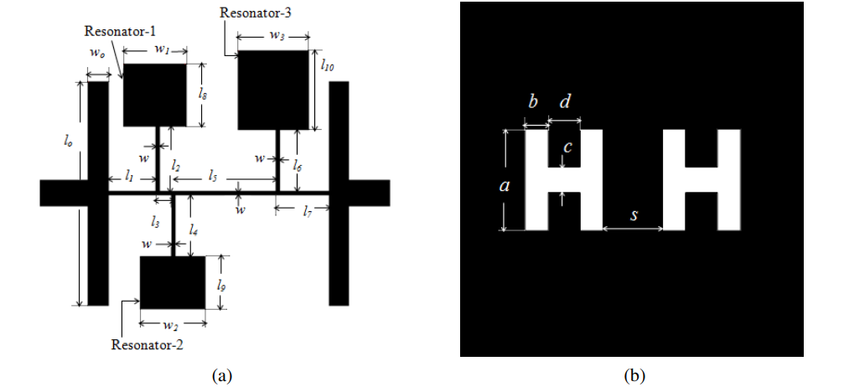
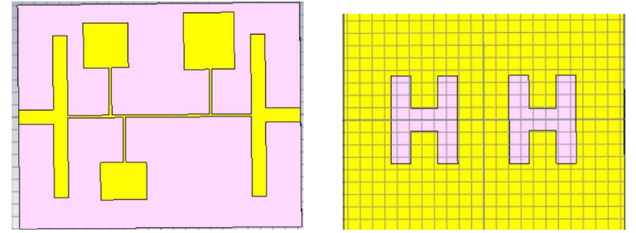
proposed Filter-1
consists of two symmetric H-shaped DGSs etched on the ground metallic plane of the basic lowpass filter structure
The stopband bandwidth of the filter is improved by the use of etched units in the ground plane without increasing the physical size
Layout of the proposed Filter-1. (a) Top view. (b) Bottom view
49

Slide 50
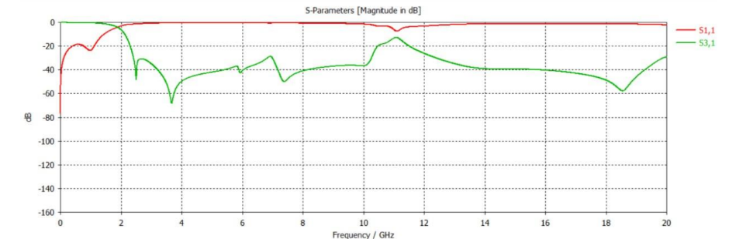
The simulated 3 dB cutoff frequency of Filter-1 is 1.945 GHz, and wide stopband bandwidth from 2.315 GHz to 20 GHz
The insertion loss is lower than 0.3 dB up to 1.1 GHz of the passband and the return loss is higher than 30.4 dB
50
Simulation results of the filter with DGS

Slide 51
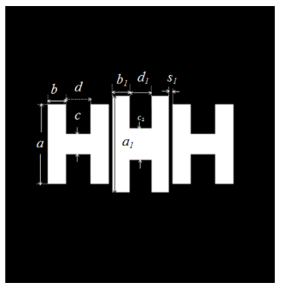
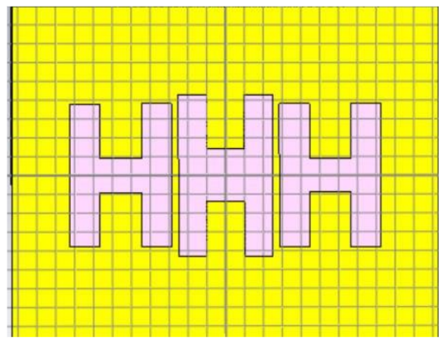
proposed Filter-2
To improve the characteristics of Filter-1, one more H-shaped slot is added to the ground plane, and the coupling between the DGS resonators is increased
51
Bottom view of filter with three H-shaped slot on ground plane

Slide 52
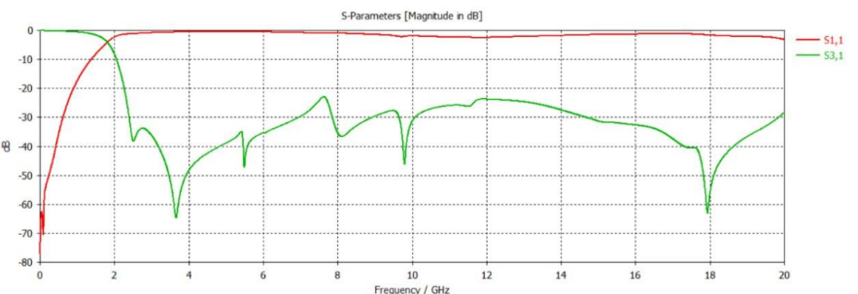
Due to increased etched area in the ground plane, the simulated 3 dB cutoff frequency of the proposed Filter-2 is reduced to 1.88 GHz.
Filter-2 has low insertion loss and high return loss values in the passband together with a wide stopband up to 20 GHz
The insertion loss in the passband is less than 0.22 dB up to 1.1 GHz, and high return loss
52

Slide 53
DESIGN OF THZ LOWPASS FILTER USING SPLIT RING RESONATOR
53

Slide 54
INTRODUCTION
Terahertz (THz) technology has emerged as a promising field with a wide range of applications.
One of the critical components in THz systems is the filter
Design and implementation of a passive low pass filter (LPF) in the THz spectrum using split-ring resonators (SRRs).
SRRs are a type of metamaterial that exhibits unique electromagnetic properties.
SRRs consist of two concentric loops with a split in both loops facing opposite to each other
54

Slide 55
Split accumulate large capacitance acrosss it.
Loop store magnetic energy
Gap between the loops is kept small
Project is to realize a novel passive LPF with acceptable electrical performance and reduced losses
No active components
55

Slide 56
SPLIT RING RESONATOR
Designed to store electromagnetic energy
Generated by the loops and split in the structure.
The dimensions of SRRs are smaller than the resonant wavelength, which increases the overall gain and reduced losses.
56

Slide 57
DESIGN AND IMPLEMENTATION
The SRRs are arranged periodically along the microstrip line, and their dimensions are optimized to achieve the desired cut-off frequency and bandwidth
At first, the frequency at which the SRR structure resonates is tuned via adjusting various parameters.
Match the input impedance of LPF to the input signal frequency spectrum
57

Slide 58
DESIGN AND IMPLEMENTATION
After that, an array of the basic unit cells (SRR) combined to form the Microstrip transmission line.
The final structure of the Passive Low Pass Filter has been printed on a Polyimide substrate .
All the potential power relationships between a microwave junction’s numerous input and output ports are given by a square matrix known as S-parameters.
The return loss measures the reflected wave to the incident wave. The lower the filter’s return loss, the better is the transmission coefficient.
58

Slide 59
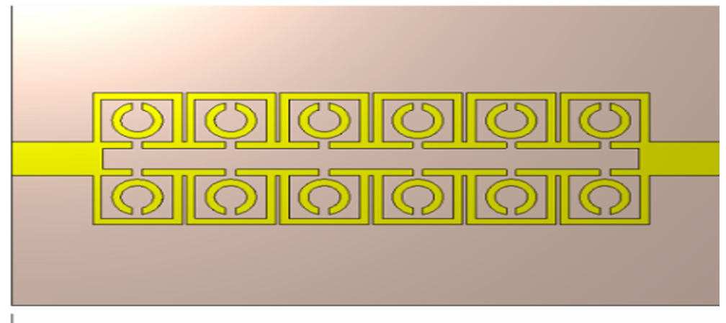
DESIGN AND IMPLEMENTATION
59

Slide 60
TESTING AND OBSERVATION
The LPF is tested for its return loss
The LPF is designed to have a cut-off frequency at fc=5.8THz and a satisfactory bandwidth with a low insertion loss.
Also, from the conventional procedure, miniaturization at the nanoscale is required for the same values.
This is not possible because of various fabrication challenges as the length and width are in nanometers. Hence,metamaterials have been proposed
60

Slide 61
TESTING AND OBSERVATION
The unit cells of the proposed filter have their electrical dimensions as λ/4 of the waveguide.
Therefore, in this paper, we propose a THz lowpass filter using a planar circular resonator.
61

Slide 62
RESULT AND DISSCUSSION
The computed outcome of the filter shows a cut-off frequency at fc=5.8 THz.
A good sharpness of the filter response is achieved in the frequency range of 6–7 THz
There are three resonance points in the filter having six SRR while others have one or at maximum two.
62

Slide 63
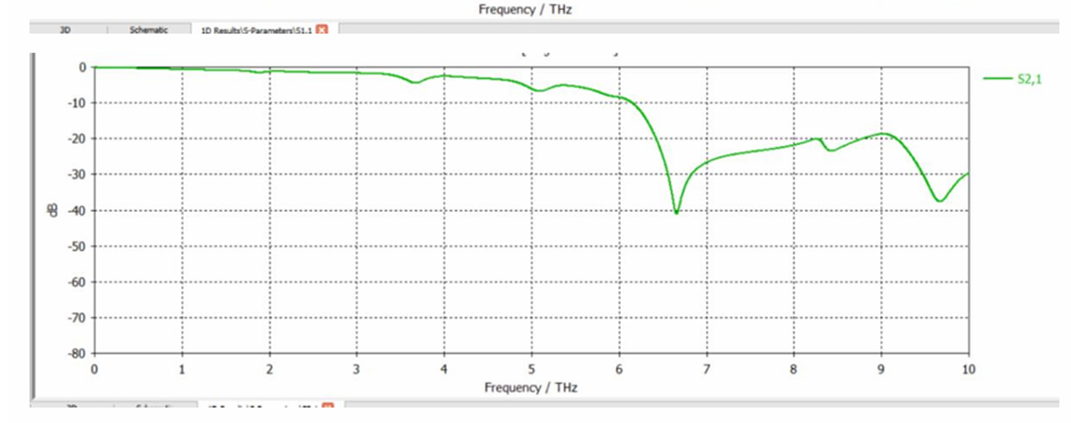
RESULT AND DISSCUSSION
63

Slide 64
CONCLUSION
64

Slide 65
In summary, microwave filters in the GHz and THz frequency ranges are indispensable tools for engineers and researchers working in wireless communication, radar, terahertz imaging, and related fields. By understanding the principles and design considerations of microwave filters, we can unlock new possibilities for innovation and technological advancement in the GHz and THz spectrum.Our study was on different type of microwave filters and through this project we were able to get insights into different type of microwave filter designs.
65

Slide 66
Thankyou
65

